Slide 1
M.I.L.K. Maternal Immunotherapy through Lactation and Kangaroo Care
Sonya “Nikki” McLaughlin, BSN, CCRN
East Carolina University College of Nursing
November 8, 2013
Notes:
Hi everyone! I hope all is well as we wind down the semester. This is my Journal club presentation and as you can see, it is on oral colostrum. I choose a 2010 article that did not have remarkable results, but still managed to have a huge impact on the care of our population. This study, entitled “A Pilot Study to Determine the Safety and Feasibility of Oropharyngeal Administration of Own Mother’s Colostrum to Extremely Low Birth Weight Infants,” was the first research study conducted to investigate an alternative method to provide beneficial, nutrient rich colostrum to the tiniest, most at risk patients we see in the NICU.

Slide 2
Objectives
Define Oral Immunotherapy
Review Components of Colostrum
Review The Barriers To Providing Milk
Review The Pilot Study And Results
Discuss The Impact To The NICU Population
Discuss Situations To Improve Practices

Slide 3
What is Oral Immunotherapy?
Notes:
Before we move any further, let’s talk about oral immunotherapy. What exactly is it? Oral immunotherapy involves placing small amounts of colostrum directly on the oral mucosa with the expectation that the colostrum or select components will then be absorbed by the mucosal membranes on the mouth and pharynx.

Slide 4
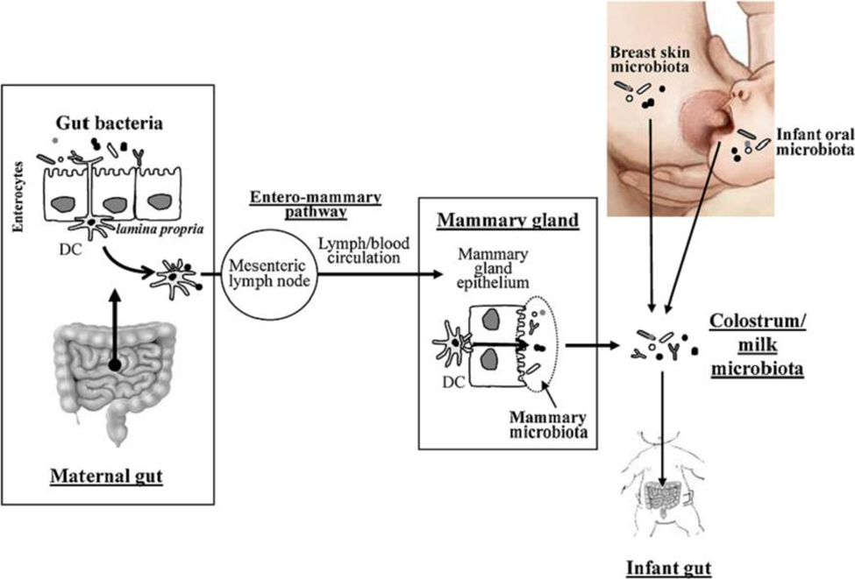
Pathophysiology and Historical Significance of Colostrum
Pre-milk Substance
High in Protein, Low in Fat
Immune Agents are able to Pass through Blood into Milk
Produced in the First 2-4 Days
Differs From Breast Milk
Dubbed “Liquid Gold”
Notes:
Colostrum is the early milk that is produced when the tight junctions in the mammary epithelium are open, allowing paracellular transport of many immunologically derived protective components from the mother’s circulation into the milk. Historically, colostrum has been used for thousands of years to treat various illnesses. In the early 20th century, it was noted that the antibody composition of milk in the first few days following life was significantly higher than milk produced after 72 hours. There are now thousands of articles advocating for the use of colostrum and breast milk and the benefits they possesses. So what is in colostrum?

Slide 5
Got MILK?
Immune Factors
Growth Factors
Specific Antibodies
Immunoglobulins (IgA, IgD, IgE, IgM, IgG)
Prolin Rich Polypeptides
Lactoferrin
Cytokines
Lymphokines
Oligopolysaccharides and Glycoconjugate Sugars
Glycoproteins and Trypsin Inhibitors
Lysozymes
Leukocytes
Lactalbumins
Lactoperoxidase-Thiocynate, Peroxidase & Xanthine Oxidase Enzymes
Insulin Like Growth Factor
Epidermal Growth Factor
Transforming Growth Factor
Platelet Derived Growth Factor
Transfer Factor
Notes:
There are approximately 90 know components in colostrum. The two primary components are listed and include immune factors and growth factors. In addition to the immune and growth factors, colostrum also has vitamins, minerals, and amino acids specific to the needs of the neonate. The ones most pertainant to this discussion are sIgA and lactoferrin. Secretory IgA is one of five immunoglobulins in colostrum. sIgA is stable against enzymes in the infants gut and has the ability to bind to bacterial and viral agents promoting inhibition of attachment to the mucosal lining. sIgA accounts for 90% of total immunoglobulins in milk. Lactoferrin is a multi-faceted protein and, with approximately 6mg/ml, is the major whey protein in human colostrum. It is both bacteriostatic (it can inhibit bacterial growth by binding iron which some bacteria need to grow) and bacteriocidal (kills bacteria). At high concentrations, lactoferrin enhances proliferation of enterocytes and closure of enteric gap junctions. Al lower concentrations, lactoferrin stimulates differentiation of enterocytes and expression of digestive enzymes. It also has immunomodulary effects and is a growth factor. To add some emphasis for the ELBW population, recent research has determined that there is an inverse relationship between the concentration of protective immune factors in colostrum and the duration of pregnancy. Of course, that means these protective factors are higher in women who deliver ELBW infants.

Slide 6
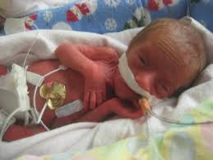
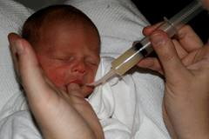
Complement with Colostrum
OG/NG Feeds
Oral Colostrum
VS
Notes:
So at this point, you may be asking yourself “self, don’t you get all the benefits of the colostrum with trickle feeds?” Well, the answer is not necessarily. Cytokines present in breastmilk may interact with lymphoid cells within the infant’s oropharyngeal associated mucosal tissues and oligosaccharides may provide local barrier protection, based on their ability to inhibit the adhesion of pathogens to cell surface receptors. What in the world does that mean? These authors state that during feeding at the breast, the exogenous cytokines in mother’s milk may stimulate the infant’s oropharyngeal-associated lymphoid tissue (OFALT) and gut-associated lymphoid tissue (GALT), in a synergistic manner, with a combined response potentially greater than that for a single site of stimulation. For the infant in the NICU who is receiving enteral trickle feeds via an NG/OG, would not have contact with OFALT or mucosal membranes. It’s kind of like putting salt on watermelon to make it sweeter. While trickle feeds are undoubtedly beneficial, the addition of oral colostrum is a complement, making it even better. Once again, they are not the same thing.

Slide 7
Perceived Barriers
As Clinicians
Maternal
Clinical Instability
Gastrointestinal Immaturity
Lower Gestational Age
Irregular/Infrequent emptying of the breast
Increases separation
Decreased skin-to-skin contact
Maternal stress and fatigue
Young maternal age
Low maternal income

Slide 8
What is the Problem Being Researched?
“To determine the safety of oropharyngeal administration of own mother’s colostrum to ELBW infants in first days of life. A secondary purpose was to investigate the feasibility of (1) delivering this intervention to ELBW infants in the first days of life, and (2) measuring concentrations of secretory immunoglobulin A (sIgA) and lactoferrin in tracheal aspirate secretions and urine of these infants”
Notes:
We’ve covered a lot of information so far, let’s move into the actual research. It should be noted that while the authors did not discuss their literature search, they do discuss other therapies that have been successful using the oropharyngeal method.
The problem these authors were trying to solve is how to deliver colostrum to ELBWs in the first few days of life. In addition, they hypothesized that there would be an increase of secretory immunoglobulin A (sIgA) and lactoferrin in both tracheal aspirates and urine of these infants. Theoretically, oropharyngeal administration of colostrum would provide local barrier protection and change levels of immunologically-derived factors, such as secretory immunoglobulin A and lactoferrin, in bodily fluids.

Slide 9
What is the Question being Asked? (And Why should we Care?)
How can we Deliver Colostrum to these Infants?
Does Oral Colostrum Improve Outcomes?
Is Oropharyngeal Colostrum Safe ?
Notes:
In light of the mountain of research regarding the benefits of colostrum in the first few days of life, these authors were looking for alternate ways to provide colostrum to these infants. Their questions were how can we get this milk to the baby? Is this method safe? And does it work?
Why should we care? We all are aware of the short and long term morbidities associated with the NICU particularly in infants born at lower gestations and birth weights. Nosocomial infections, NEC, IVH, PVL, visual and hearing impairments, CP, and cognitive and motor disabilities are among the most common complications seen in our population. Two of these, infection and NEC, can be augmented by the administration of breast milk. Recent data show that as many as 65% of ELBW will have at least one infection during their hospitalization. Research has linked maternal milk with a lower incidence of nosocomial infections in VLBWs compared to formula fed infants. With regard to the gastrointestinal system, an inability to feed enterally can lead to intestinal atrophy, which increases inflammation, feeding intolerance, NEC, and nosocomial infection. By providing these infants with all therapies available, we have the ability to decrease these morbidities and improve patient outcomes.

Slide 10
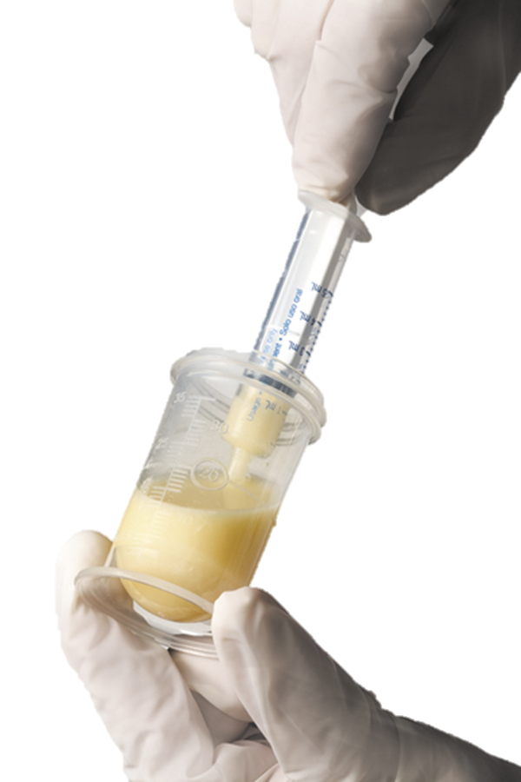
Research Design and Methods
Design
Variables
One group
Pre/Post Test
Quasi Experimental
Independent
Oropharyngeal Colostrum
Dependent
sIgA of Urine and Tracheal Aspirate
Lactoferrin of Urine and Tracheal Aspirate
Syringes of 0.2ml of Colostrum; 0.1ml delivered to each cheek Q2 for 48 hours
Methods
Notes:
This pilot study used a quasi-experimental, one group, pretest- posttest design. The independent variable was the oropharyngeal administration of own mother’s colostrum. The dependent variables were sIgA and lactoferrin concentrations in the infant’s tracheal aspirates and urine before and after treatment with colostrum.
Seventeen mothers in total were approached and of those, 15 agreed to participate in the study. Of these women, 10 sustained their pregnancy beyond 28 weeks excluding them from the study. The five remaining women were enrolled. Informed consent was obtained prior to birth and baseline tracheal aspirates were obtained in the delivery room prior to administering surfactant. Within 24 hours of delivery, the participating mothers were approached and educated on how to provide sufficient colostrum. Using sterile technique, colostrum was transferred into small syringes, each with 0.2mls. Each infant then received 0.1ml of colostrum along the buccal mucosal tissues. This was repeated every 2 hours over a period of 48 hours, beginning within 48 hours of life.
A total of 5 ELBWs participated in the study. Of the three males and two females, mean birth weight was 657 grams, mean gestational age was 25.5 weeks, two infants were Caucasian, two were African American, and one was Middle-Eastern.
Enzyme linked immunoassay kits were used to measure sIgA and lactoferrin concentrations in the urine and tracheal aspirates.

Slide 11
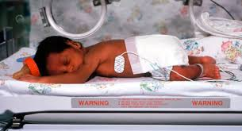
Inclusions and Exclusions
inclusions
Exclusions
Birth weight of <1000g
Gestation of <28 weeks
Appropriate for gestational age
Congenital Anomalies
Gastrointestinal Disorders
Renal Disorders
Vasopressors
Maternal Substance Abuse
Positive maternal HIV status
Notes:
Inclusion criteria were birth weight of <1000g, <28 weeks gestation, and appropriate for gestational age
Exclusion criteria were infants with congenital anomalies, gastrointestinal disorders, renal disorders, vasopressors >10mcg/kg/min, maternal substance abuse, or positive maternal HIV status

Slide 12
Limitations
Insufficient Quantity to Test
Lack of Reference Values
Small Sample Size
Notes:
Foremost, over 50% of the trach aspirates were insufficient in quantity for analysis. Another limitation was noted to be the lack of reference values for immune markers in ELBWs in the first days of life. The only existing values for immune markers are for larger preterm or term infants. An additional limitation was the small sample size of the research study.

Slide 13
Results
Sample Source | Usable‘n’ | Median | Minimum | Maximum
sIgA Urine ng/ml | 14 | 83.3 | 0.8 | 167
sIgA Tracheal Aspirate ng/ml | 7 | 91,470 | 5.8 | 183,000
Lactoferrin Urine ng/ml | 14 | 278.6 | 1.34 | 556
Lactoferrin Tracheal Aspirate ng/ml | 7 | 90 | 16 | 164
“this pilot study showed that oropharyngeal administration of own mother’s colostrum is easy, inexpensive, and well-tolerated by even the smallest and sickest ELBW infants”
Notes:
All of the infants enrolled were able to complete the entire protocol, each receiving a total of 24 treatments during 48 consecutive hours. The first treatment was given to all of the infants within the first 48 hours of life.
Clinically speaking, the authors found that for all of the infant’s, oxygen saturations remained stable or improved, there were no episodes of apnea, bradycardia, hypotension or other adverse effects. The infants also all demonstrated sucking on their ET tubes.
There was a wide variety in concentrations of sIgA and lactoferrin in both urine and tracheal aspirates among the five infants as shown in the table above. Data from some samples could not be obtained due to sample size or dilution.
This pilot study showed that oropharyngeal administration of own mother’s colostrum is easy, inexpensive, and well-tolerated by even the smallest and sickest ELBW infants.

Slide 14
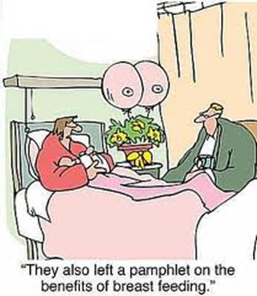
Implications for Practice
Incorporate Oral Colostrum into Feeding Roadmap
Encourage early and frequent Pumping
Offer support for Continued Pumping Effort
Facilitate Kangaroo Care when Appropriate
GIVE THE COLOSTRUM!!!!!
Notes:
The amount and quality of research completed and attesting to the benefits of human milk is undeniable. The role of human milk in decreasing the risk of NEC, decreased risk of nosocomial infection, and increasing positive outcomes within our population is magnanimous. With this knowledge in mind, the challenge now becomes providing colostrum and breast milk to all infants in our care and more specifically those at highest risk for morbidities in the NICU. The easiest way to institute change, that I can see, is the addition of oral colostrum to an established feeding protocol. In addition to the benefits of breast milk, an established standardized feeding protocol promotes optimal nutrition in the infant and decreases the time it takes to achieve full feeding volumes. Instituting an oral colostrum protocol in conjunction with a feeding roadmap not only encourages immunotherapy and nutrition, but also facilitates bonding with the mother as she continues to provide milk. Kangaroo care should be instituted as soon as the infant is clinically stable enough to do so in order to facilitate bonding, promote autonomic stability in the infant, and increase maternal milk supply.

Slide 15
Colostrum in the Future
Lactoferrin Therapy
Bovine Colostrum?
Notes:
This study has verified the safety of administering colostrum to ELBWs despite their limitations. Using colostrum in this manner, as immune therapy, forces a change in thinking from using colostrum solely for nutrition.
Moving forward, there is emerging research regarding the use of bovine colostrum and more specifically, bovine lactoferrin. One Italian study found that supplementing lactoferrin in the milk of infants weighing less than 1500 g reduced infection after 72 hours of life, but not NEC. Furthermore, a Cochran review released in 2011 endorses and encourages further research be conducted into the efficacy of this treatment and found the preliminary research studies promising. While current studies discuss the use of enteral bovine lactoferrin, the possibility exists that positive outcomes in this research could translate to oral bovine colostrum.

Slide 16
References
Abrams, S. A., & Hurst, N. M. (2012). Breast milk expression for the preterm infant. Retrieved from www.uptodate.com
Castellote, C., Casillas, R., Ramírez-Santana, C., Pérez-Cano, F., Castell, M., Moretones, M. G., . . . Franch, A. (2011). Premature delivery influences the immunological composition of colostrum and transitional and mature human milk. Journal of Nutrition, 141(6), 1181-1187. doi:10.3945/jn.110.133652
Godhia, M. L., & Patel, N. (2013). Colostrum- its composition, benefits, as a nutraceutical: A review. Current Research in Nutrition and Food Science, 1(1), 37-47.
Lactoferrin immunoprophylaxis for very preterm infants. (2013). Archives of Disease in Childhood -- Fetal & Neonatal Edition, 98(1), F2-4. doi:10.1136/archdischild-2011-301273
Lönnerdal, B. (2013). Bioactive proteins in breast milk. Journal of Paediatrics & Child Health, 49, 1-7. doi:10.1111/jpc.12104
McCallie, K. R., Lee, H. C., Mayer, O., Cohen, R. S., Hintz, S. R., & Rhine, W. D. (2011). Improved outcomes with a standardized feeding protocol for very low birth weight infants. Journal of Perinatology, 31, 61-67.
Meinzen-Derr, J., Poindexter, B., Wrage, L., Morrow, A. L., Stoll, B., Donovan, E. F., & The National institute of Child Health and Human Development Neonatal Research Network. (2009). Role of human milk in extremely low birth weight infants’ risk of necrotizing enterocolitis or death. Journal of Perinatology, 29(1), 57-62. doi:10.1038/jp.2008.117

Slide 17
References
Pammi, M., & Abrams, S. A. (2011). Oral lactoferrin for the prevention of sepsis and necrotizing enterocolitis in preterm infants. Cochrane Database of Systematic Reviews, (10).
Patel, A.L., Johnson, T. J., Engstrom, J. L., Frogg, L. F., Jeiger, B. J., Bigger, H. R., & Meier, P. P. (2013). Impact of early human milk on sepsis and health-care costs in very low birth weight infants. Journal of Perinatology, 1-6.
Pletsch, D., Ulrich, C., Angelini, M., Fernandes, G., & David S.C., L. (2013). Mothers' "liquid gold": A quality improvement initiative to support early colostrum delivery via oral immune therapy (OIT) to premature and critically ill newborns. Canadian Journal of Nursing Leadership, 26, 34-42.
Rawal, P., Gupta, V., & Thapa, B. R. (2008). Role of colostrum in gastrointestinal infections. Indian Journal of Pediatrics, 75(9), 917-920.
Rodriguez, N. A., Meier, P. P., Groer, M. W., & Zeller, J. M. (2009). Oropharyngeal administration of colostrum to extremely low birth weight infants: Theoretical perspectives. Journal of Perinatology, 29(1), 1-7. doi:10.1038/jp.2008.130
Rodriguez, N. A., Meier, P. P., Groer, M. W., Zeller, J. M., Engstrom, J. L., & Fogg, L. (2010). A pilot study to determine the safety and feasibility of oropharyngeal administration of own mother's colostrum to extremely low-birth-weight infants. Advances in Neonatal Care (Elsevier Science), 10(4), 206-212. doi:10.1097/ANC.0b013e3181e94133
All images obtained from Google Images

Slide 18
FIN
Notes:
That’s it! Stay tuned for my captivating quality improvement proposal on the same topic. ☺

