Slide 1
Posterior Urethral Valves
Sonya “Nikki” McLaughlin
East Carolina University, College of Nursing
October 4, 2013

Slide 2
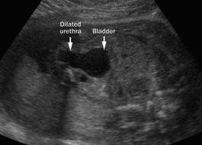
Prenatal history
20 y.o. now Gravida 1 Para 1
Blood Type B+
HepB negative
Rubella immune
Syphilis nonreactive
HIV negative
GBS negative
Pregnancy Complications: None
Significant Maternal Conditions: None
Fetal Ultrasound …..
Oligohydramnios
Bilateral hydronephrosis
Thickened bladder wall
Positive keyhole sign

Slide 3
Delivery history & Transfer summary
Delivery Stats
Life Flight
Estimated 34 week, male infant
Delivered vaginally, spontaneous
NO amniotic fluid
Resuscitation per NRP guidelines
Intubated at 3 minutes of life
Apgar scores of 4, 5, and 7
Birthweight of 2.32kg, AGA
8 hours of life
Transferred from level II
Profound respiratory failure
Intubated on conventional ventilator
Very little diagnostic testing at outside facility

Slide 4
Admission management

Slide 5
Differential and diagnostics
Differential Diagnoses
Diagnostic Testing
Pre-Renal Failure
  Sepsis
  Hypoxia
Intrinsic Renal Failure
  Congenital Anomalies
  Thromboembolic Disease
  Infection/Inflammation
Post-Renal Failure
  Posterior urethral valves
  Bilateral ureteropelvic junction obstruction
  Neurogenic bladder
Diagnostic Testing
Chest Xray
KUB
ECHO
Renal ultrasound
Blood work (ABG, CMP, ABCD, DIC panel, blood cultures)

Slide 6
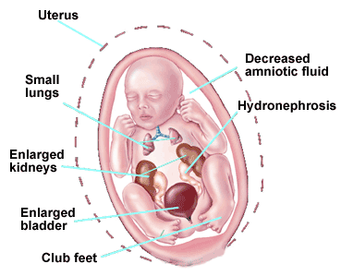
Admission assessment
Observation
  Bell shaped chest
  Widely spaced nipples
  Abdominal distention
  Club feet
Palpation
  Bilateral abdominal masses
  Palpable bladder

Slide 7
Posterior urethral valves
Management and Treatment

Slide 8
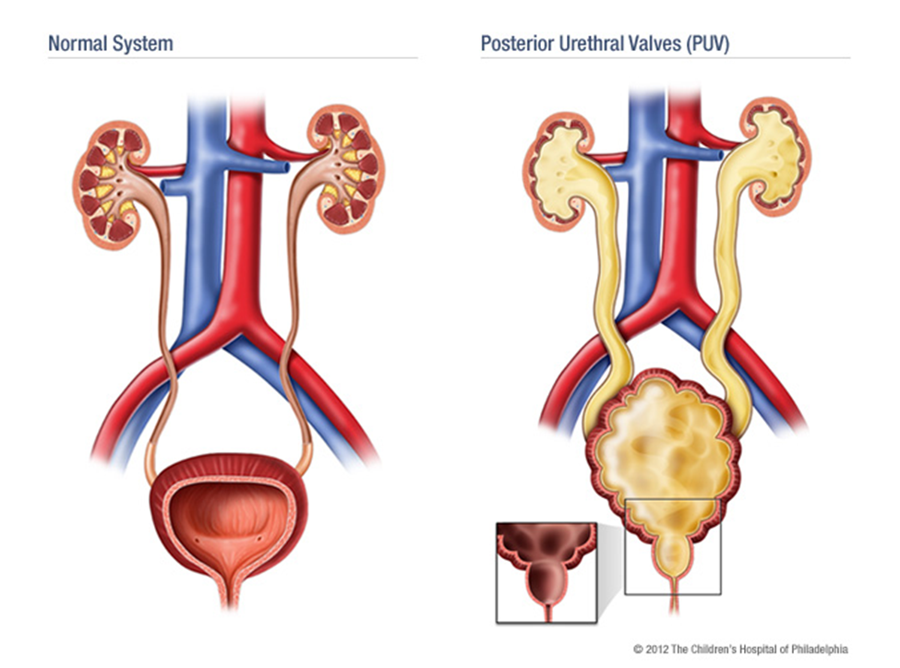
Posterior urethral valves
Definition
Epidemiology
Occurs in 1 per 5000 live births
Disproportionately higher incidence in African- Americans and in Down Syndrome

Slide 9
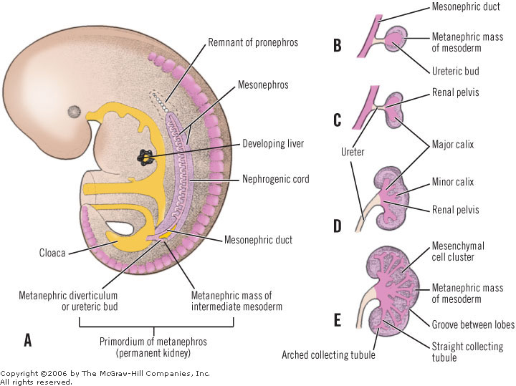
Posterior urethral valves
Embryology

Slide 10
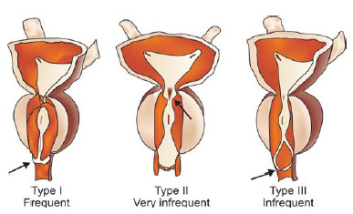
Posterior urethral valves
Classification of Posterior Urethral Valves

Slide 11
Current diagnoses
Diagnoses
Medications
Respiratory Insufficiency
Posterior Urethral Valves
Electrolyte Imbalances
Observation for urosepsis
Alteration in feeding and nutrition
34 week gestation
Ampicillin
Cefotaxime

Slide 12
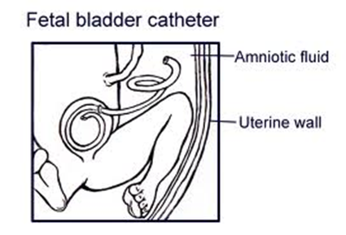
Posterior urethral valves- treatment
Prenatal Treatment
Neonatal Interventions
Foley catheterization
Transurethral ablation of the valves
Vesicostomy if indicated

Slide 13
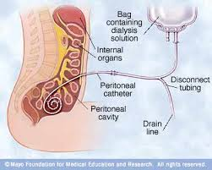
Posterior urethral valves- alternatives
Peritoneal Dialysis

Slide 14
Posterior urethral valves- complications
Chronic renal insufficiency
Recurrent UTI
Poor bladder function
End stage renal disease
Kidney transplant
Death

Slide 15

Family centered care

Slide 16
References
Botwinski, C. (2010). Renal and Genitourinary Disorders. In M. T. Verklan & M. Walden (Eds.), Core curriculum for neonatal intensive care nursing (4th ed., pp. 724-747). St. Louis, MO: Saunders Elsevier.
Casella, D., P., Tomaszewski, J., J., & Ost, M., C. (2012). Posterior urethral valves: Renal failure and prenatal treatment. International Journal of Nephrology, , 1-4. doi:10.1155/2012/351067
Hodges, S. J., Patel, B., McLorie, G., & Atala, A. (2009). Posterior urethral valves. Scientific World Journal, 9, 1119-1126. doi:10.1100/tsw.2009.127
Frost, M. S., Fashaw, L., Hernandez, J. A., Jones, Jr., M. D. (2011). Neonatal Nephrology. In S. L. Gardner, B. S. Carter, M. Enzman-Hines, & J. A. Hernandez (Eds.), Merenstein & Gardner’s handbook of neonatal intensive care (7th ed., pp. 717- 747). St. Louis, MO: Mosby Elsevier.
Unal, S., Bilgin, L., Gunduz, M., Uncu, N., Azili, M. N., & Tiryaki, T. (2012). The implementation of neonatal peritoneal dialysis in a clinical setting. The Journal of Maternal-Fetal and Neonatal Medicine, 25(10), 2111-2114. doi: 10.3109/14767058.2012.665105

Slide 17
That’s all!!

